Slide 1
JDK Service Loader

Slide 2
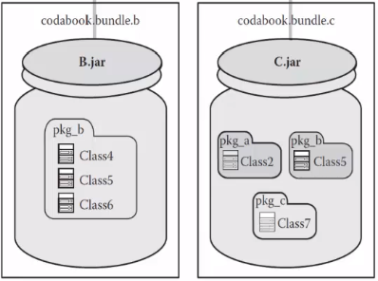
Basic Java Component Constructs
Packages
Is used to encapsulate related classes
Jar Files
Collection of classes, resources and metadata
Interfaces
Can be used to define services
Building Components
Packages as logical boundaries
Jar Files as physical boundaries
Communication through Interfaces

Slide 3
Glue Code
Instantiates objects and passes it along
Downside
Write specific glue code between every component
Hard to manage and not scalable

Slide 4
Component Models
Alternative to glue code
Automate the functionality done by glue code
Component Models
Whiteboard Model
Dependency Injection
Frameworks
OSGi, Netbeans Modules, Spring

Slide 5
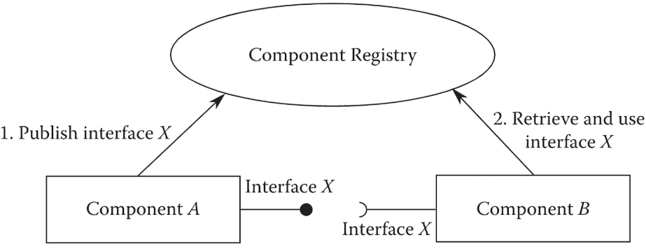
Java ServiceLoader
Whiteboard Model
A component can publish service providers to a registry
Retrieve interfaces from registry, for use

Slide 6
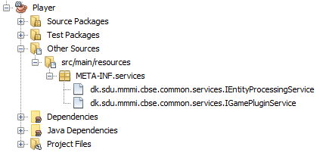

Java ServiceLoader
Registering Service Providers
Done through files

Slide 7
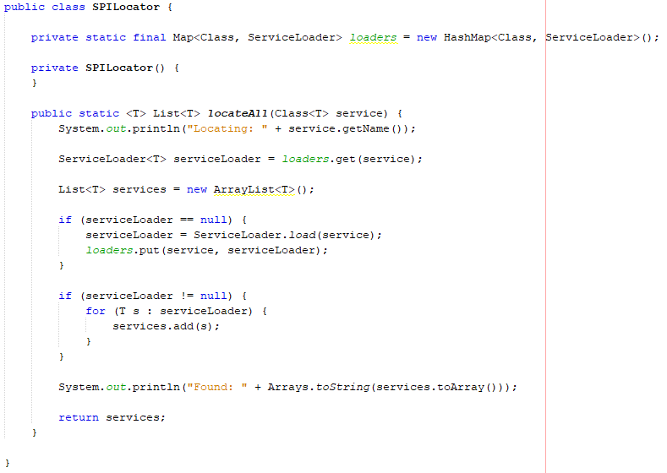
Java ServiceLoader
Accessing Services
java.util.ServiceLoader
Notes:
We get a loader that can load a specific type of service, in this example IEntityProcessingService
We load the available service providers
We iterate through them, and pick the first one
Hvis vi bruger den første kode, så skal vi altid lave en ny service loader for hver service for at forbinde to moduler, så derfor har vi i vores spils common modul lavet en metode hvor vi bruger service locator til at loade hvert service (anden kode collection extends..)

